Slide 1
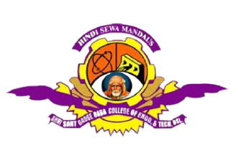
A Major – Project Presentation
Optimized Flight Reservation Using Rule-Based and Data-Driven Models
Presented by
Sejal Pramod Hivarkar
Gayatri Pramod Fegade
Uzma Ajaz Ahmad
Last Year B. Tech.,
Under The Guidance of
Dr. S. M. Shinde
Department of Artificial Intelligence and Data Science
Hindi Seva Mandal’s (Estd. 1950)
Shri Sant Gadge Baba College of Engineering and Technology,
Bhusawal – 425203, Dist. - Jalgaon, Maharashtra, India
Major-Project Presentation
1

Slide 2
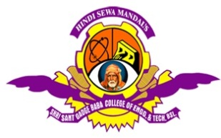
Presentation Outline
Introduction
Literature Survey
Proposed Methodology
Implementation
Applications
Advantages and disadvantages
Conclusion
References
Department of Artificial Intelligence and Data Science, SSGBCOET, Bhusawal Mini-Project Presentation
2

Slide 3
Introduction
Optimized Flight Reservation Using Rule-Based and Data-Driven Models is a web-based or application-based platform designed to simplify the process of booking airline tickets for travelers.
With the increasing demand for air travel and the need for quick, reliable, and efficient booking solutions, this system aims to automate and digitize the entire ticketing process.
It allows users to search for flights, check seat availability, make reservations, make payment and receive booking confirmations in real-time.
The project demonstrates the practical application of database management, user interface design, and backend logic, making it a significant solution in the travel and transportation domain.
Department of CSE, SSGBCOET, Bhusawal Seminar-I/Seminar-II/ Special Study/ Minor-Project Presentation
3

Slide 4
Literature Survey
This hybrid approach helps improve customer satisfaction, reduce booking errors, and increase airline revenue. The current project aims to use both these models to build an optimized and intelligent flight reservation system.
Data-driven models can analyze large amounts of historical data—including passenger trends, seasonal demand, and competitor pricing—to predict future patterns.
For example, machine learning algorithms can help suggest the best time to book a flight, adjust ticket prices dynamically, and offer personalized flight recommendations to users.
This project builds on that foundation by developing a smart flight reservation system that uses both fixed rules and intelligent data analysis to offer better results for both users and service providers.
Department of CSE, SSGBCOET, Bhusawal Seminar-I/Seminar-II/ Special Study/ Minor-Project Presentation
4

Slide 5
Proposed Methodology
The proposed flight reservation system combines rule-based logic with data-driven machine learning models to create an optimized and intelligent booking platform.
These ensure that all bookings strictly follow operational standards and legal guidelines.
Department of CSE, SSGBCOET, Bhusawal Seminar-I/Seminar-II/ Special Study/ Minor-Project Presentation
5

Slide 6
Implementation
Step1: Open Command Prompt and write “ code .” Then Enter and Run python manage.py runserver command and enter then click on IP address and CTRL + C then project are open in Browser.
Step2: Home Page are open and fill the all details and click on“Search Flight”.
Step3: Then they showed the available flights.
Step4: Fill the Ticket, Contact details and also we add coupon code here and click “Apply”.
Step5: Fill the Passenger Details and Proceed to payment.
Step6: Fill Payment Details and Make payment.
Step7: After make payment ticket will be confirmed and “Congratulations, Your flight booking is confirmed” message will shown on page and print ticket option will be available.
Department of CSE, SSGBCOET, Bhusawal Seminar-I/Seminar-II/ Special Study/ Minor-Project Presentation
6

Slide 7
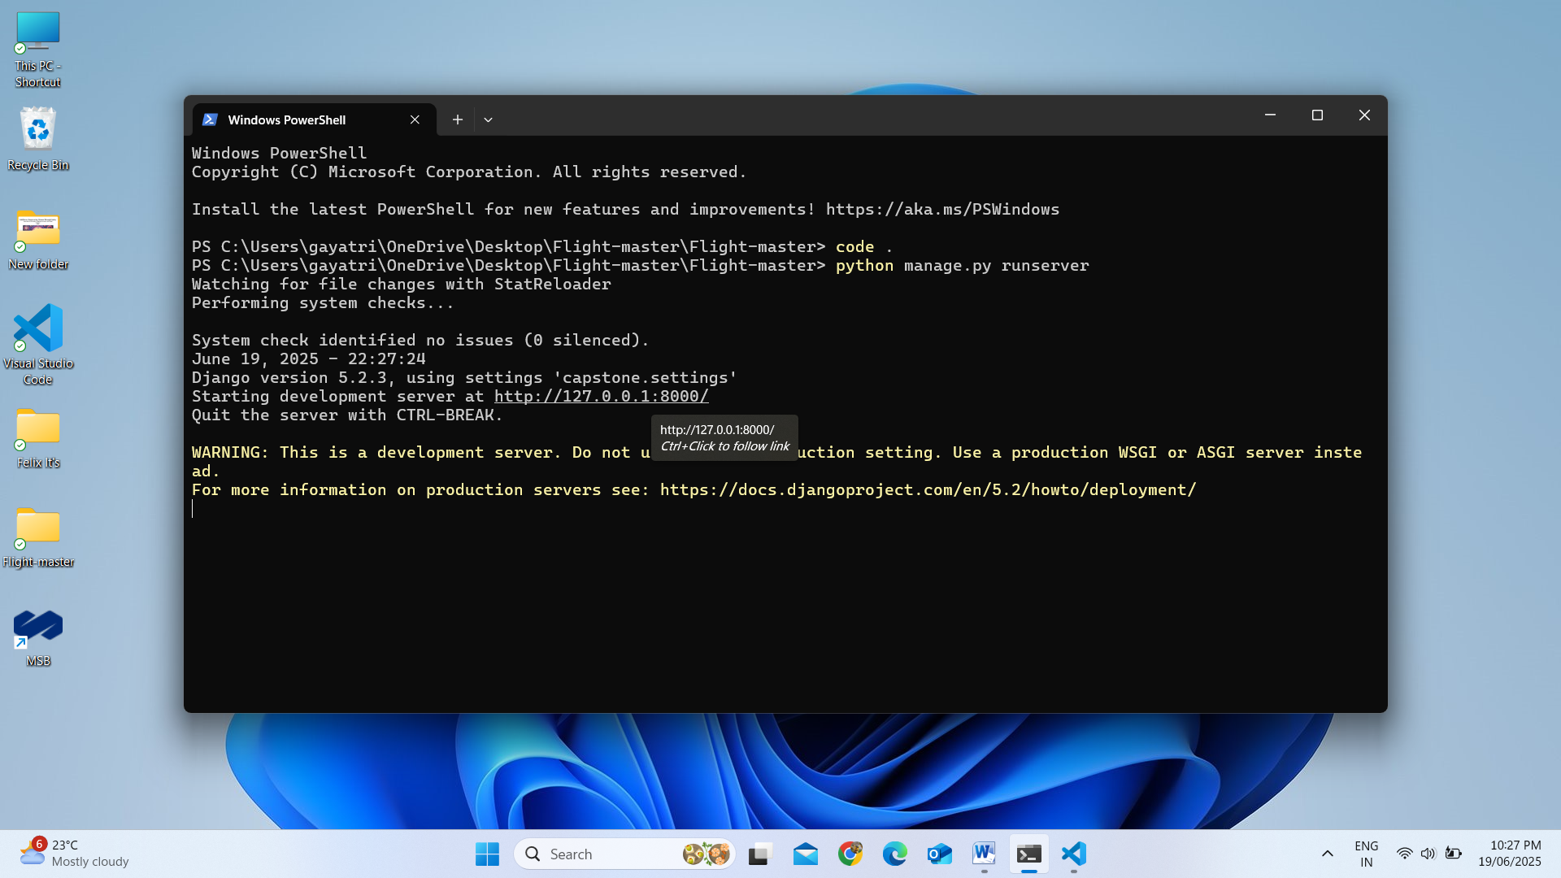
Results
1. Run Project on command prompt
Department of CSE, SSGBCOET, Bhusawal Seminar-I/Seminar-II/ Special Study/ Minor-Project Presentation
7

Slide 8
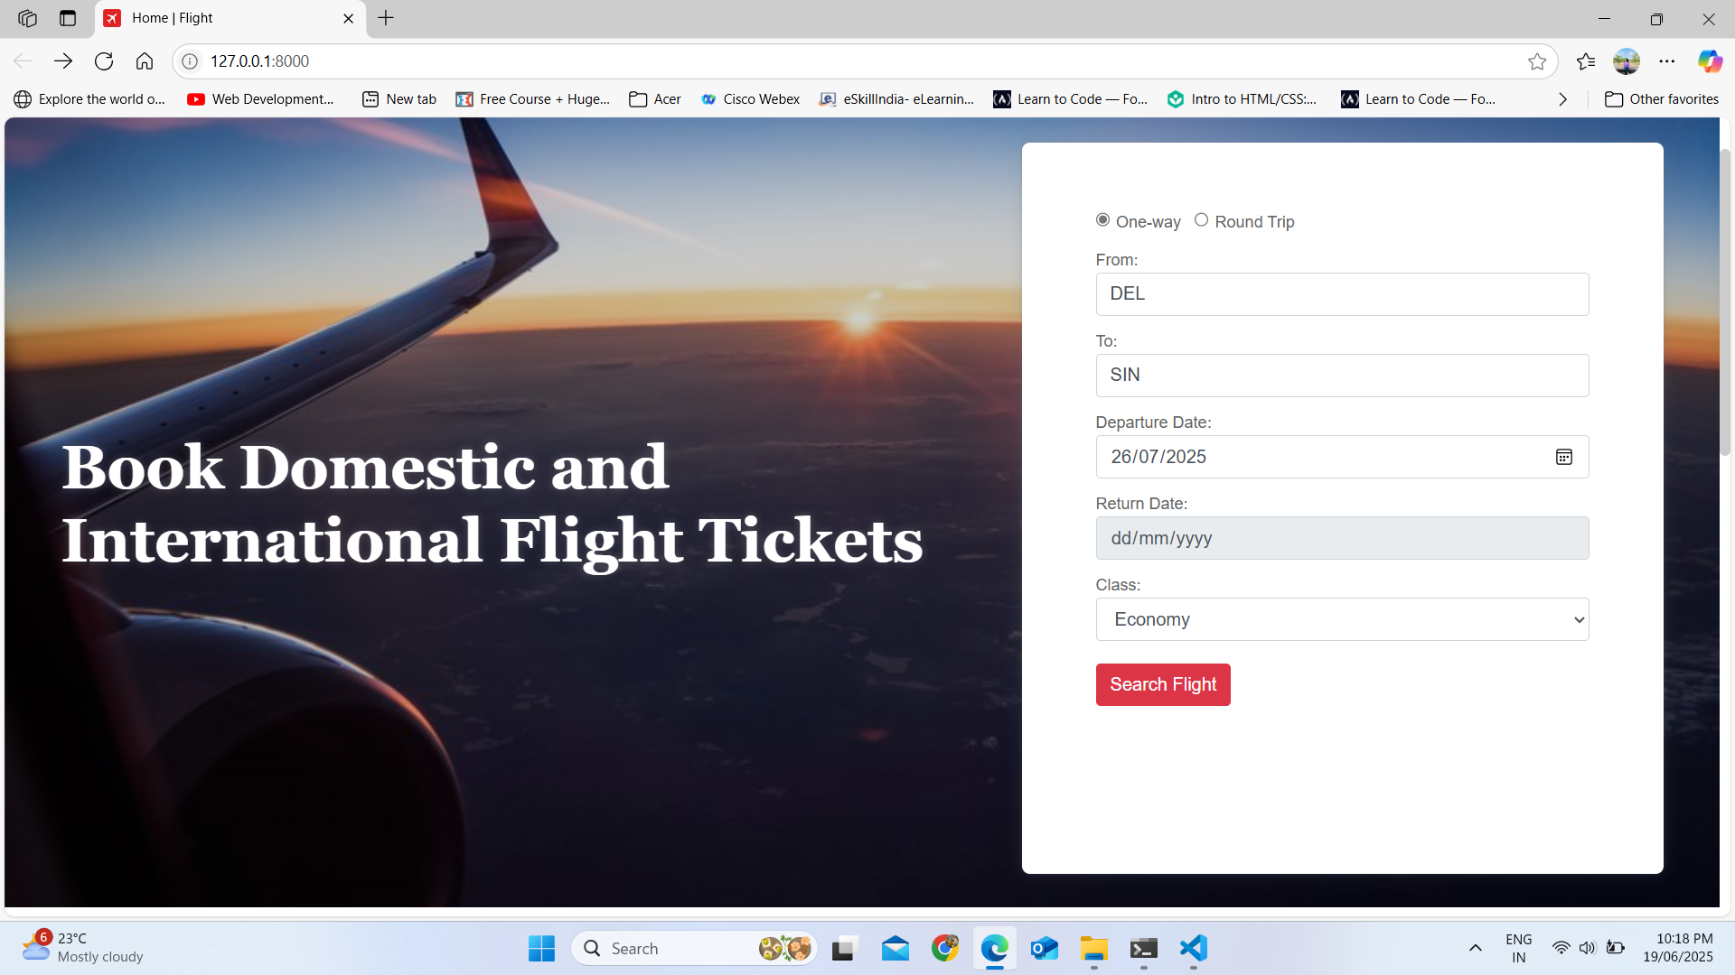
Results
2. Home Page
Department of CSE, SSGBCOET, Bhusawal Seminar-I/Seminar-II/ Special Study/ Minor-Project Presentation
8

Slide 9
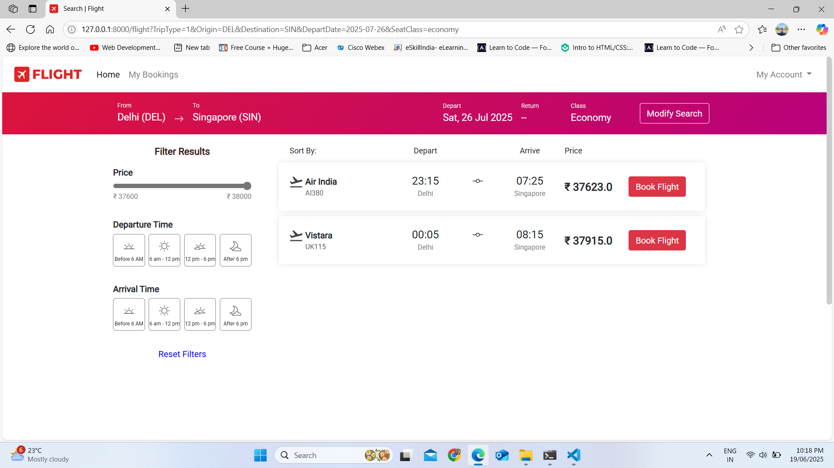
Results
3. Available flights
Department of CSE, SSGBCOET, Bhusawal Seminar-I/Seminar-II/ Special Study/ Minor-Project Presentation
9

Slide 10
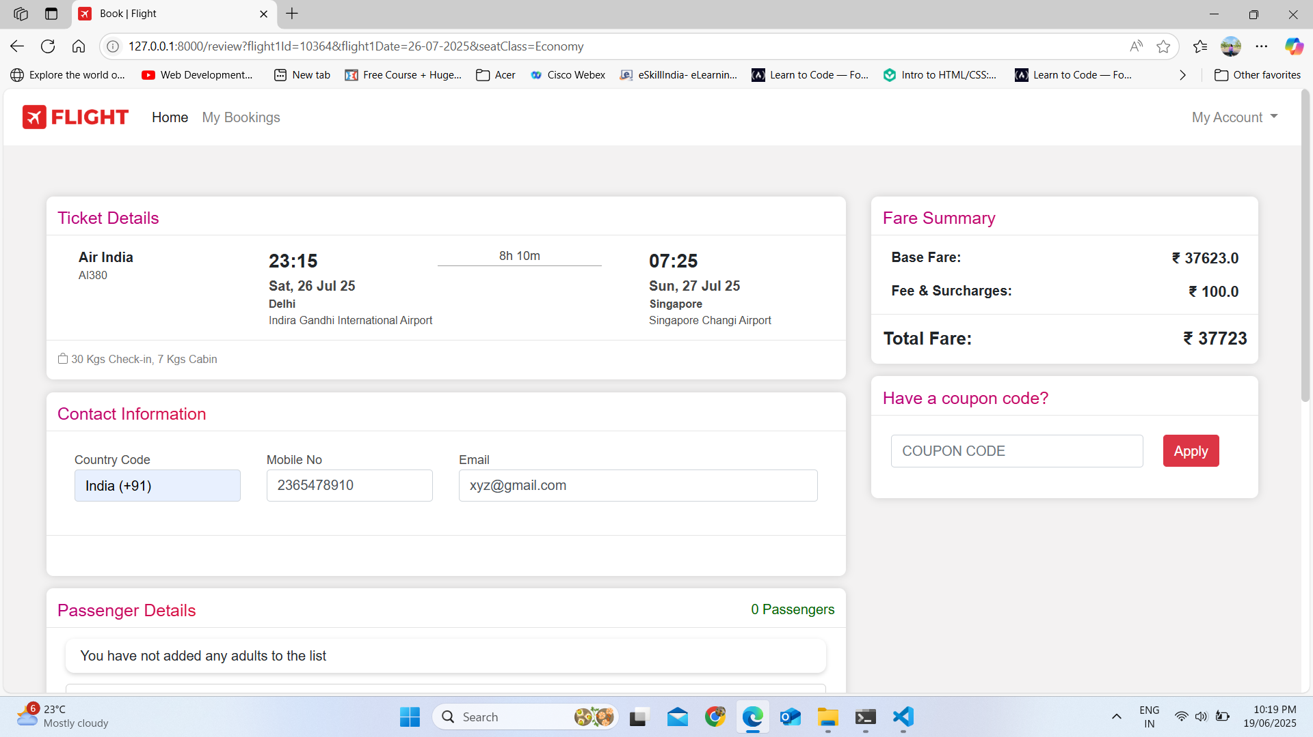
Results
4. Booking Flight
Department of CSE, SSGBCOET, Bhusawal Seminar-I/Seminar-II/ Special Study/ Minor-Project Presentation
10

Slide 11
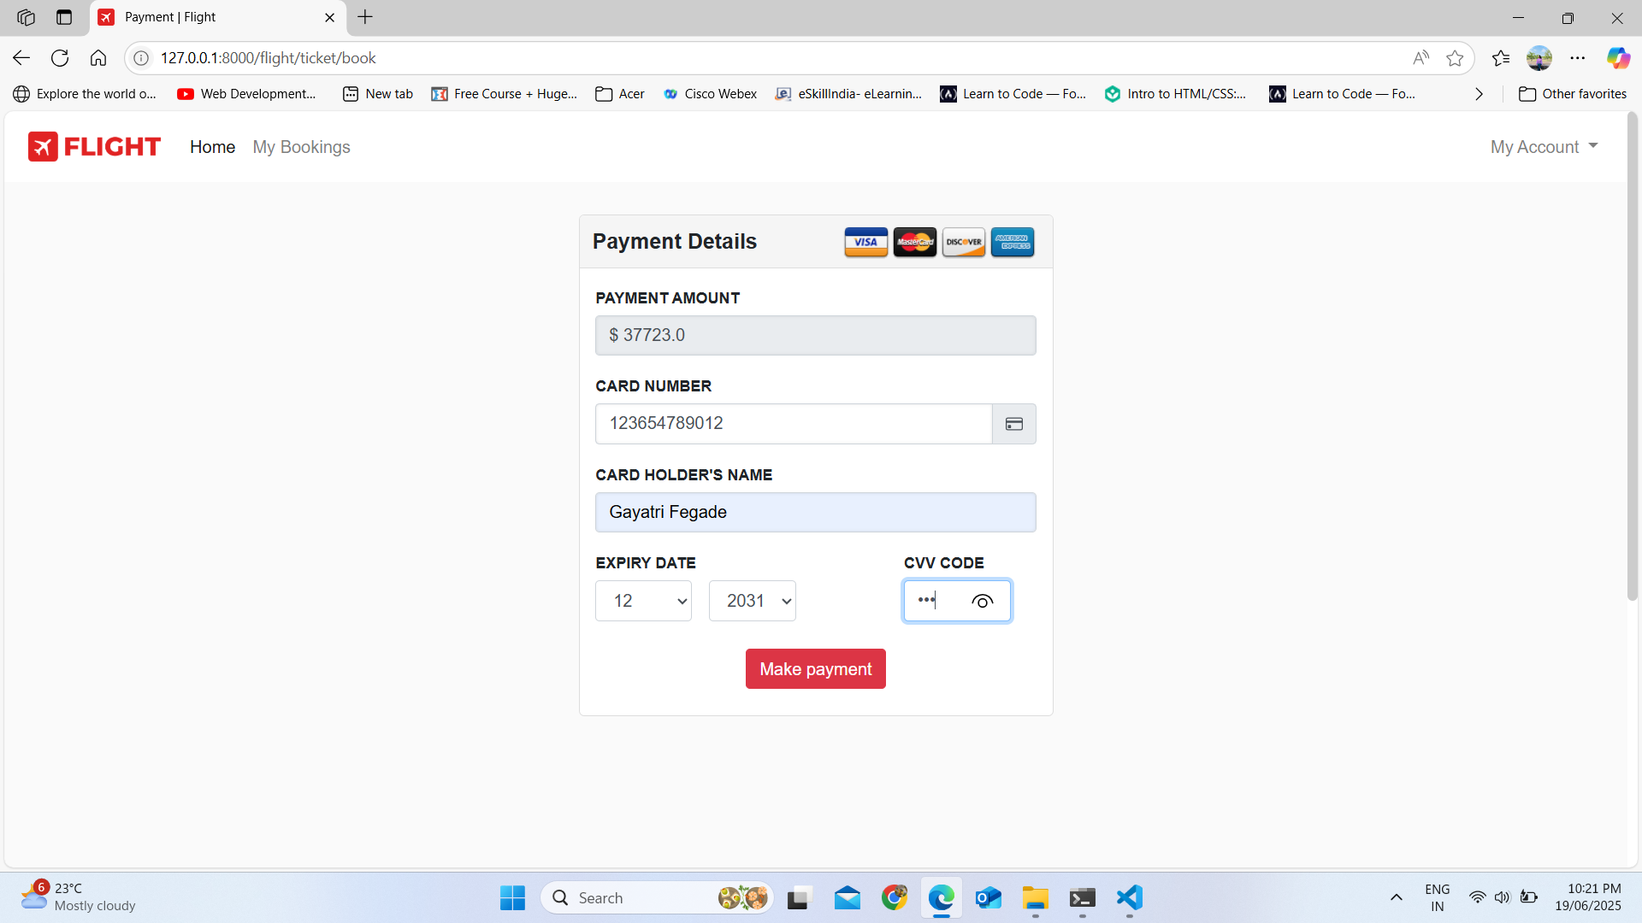
Results
5. Payment Details
Department of CSE, SSGBCOET, Bhusawal Seminar-I/Seminar-II/ Special Study/ Minor-Project Presentation
11

Slide 12
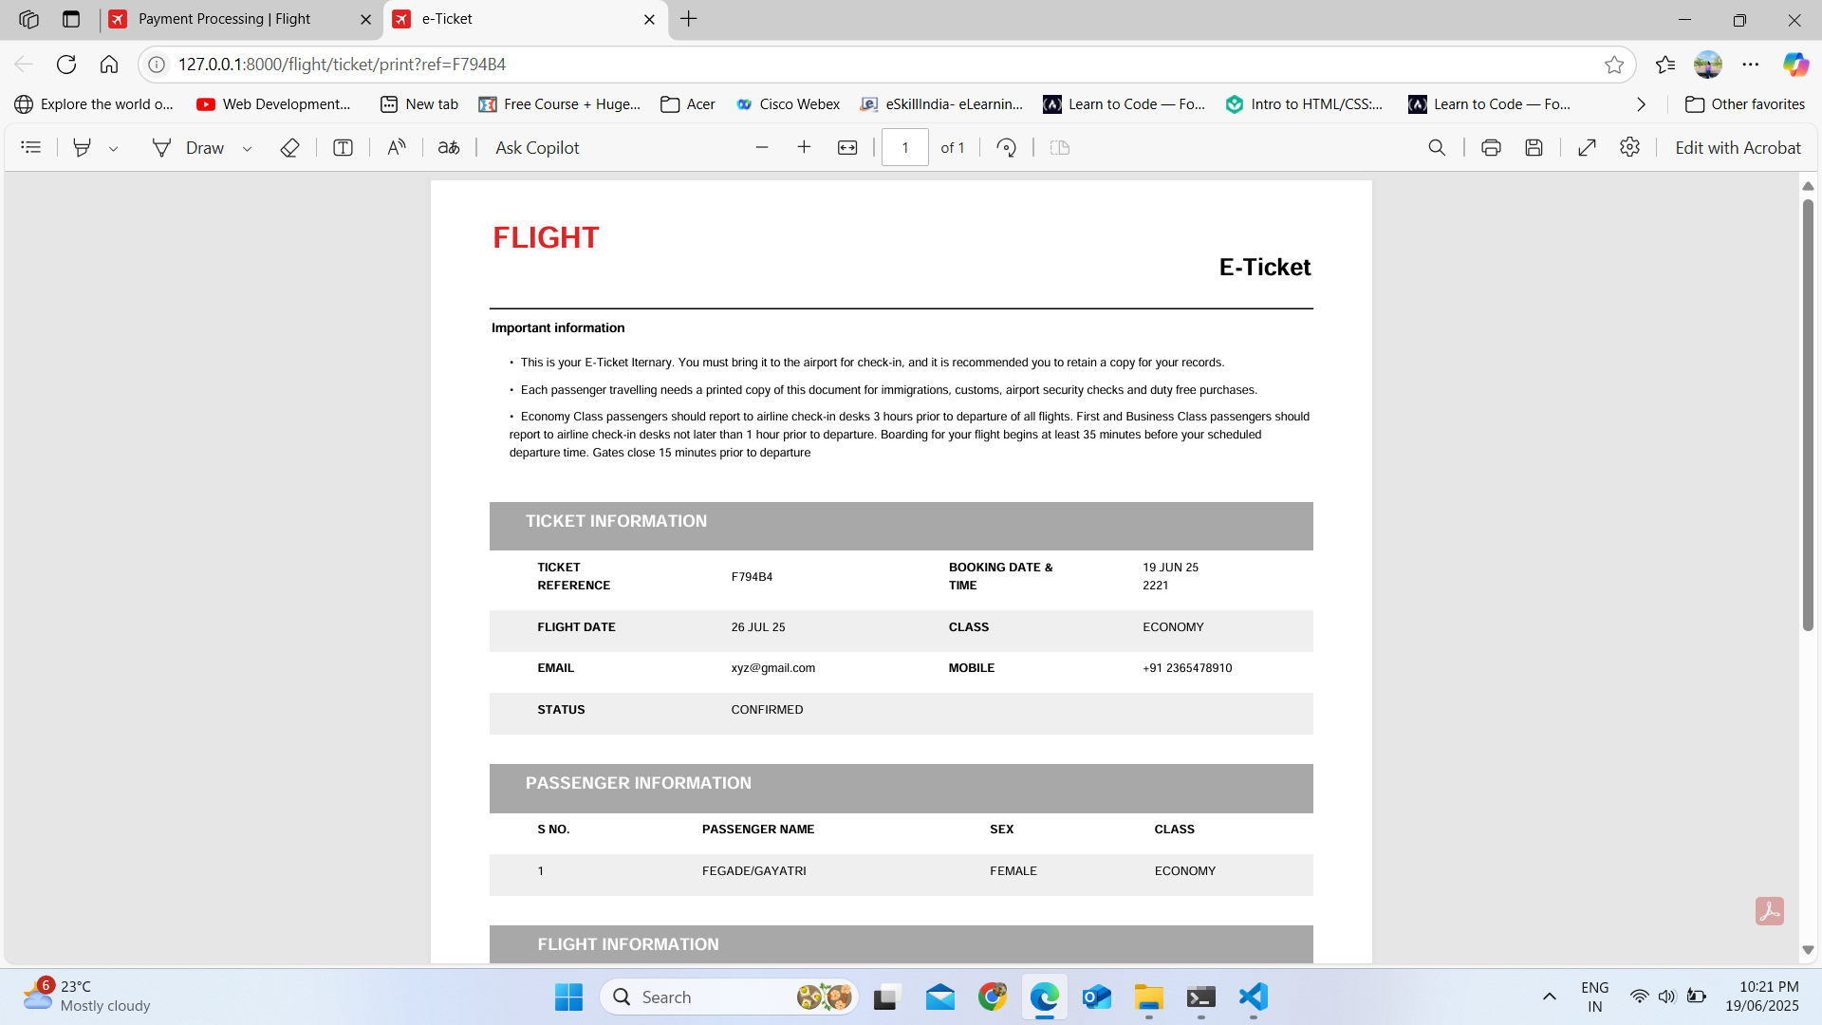
Results
6. E-Ticket Print
Department of CSE, SSGBCOET, Bhusawal Seminar-I/Seminar-II/ Special Study/ Minor-Project Presentation
12

Slide 13
Applications
User Registration and Authentication
Flight Search
Booking Process
Payment Gateway Integration
Multi-Language Support
Dialogue System
Notification System
Account Management
Department of CSE, SSGBCOET, Bhusawal Seminar-I/Seminar-II/ Special Study/ Minor-Project Presentation
13

Slide 14
Advantages and Disadvantages
Advantages
Higher Booking Accuracy
Smart Recommendations
Faster Search and Booking
Improved Customer Experience
Continuous Improvement
Disadvantages
Data Dependency
Higher Maintenance Needs
Risk of Inaccurate Predictions
Security and Privacy Challenges
Implementation Cost
Department of CSE, SSGBCOET, Bhusawal Seminar-I/Seminar-II/ Special Study/ Minor-Project Presentation
14

Slide 15
Conclusion
This Flight Booking System successfully demonstrates how a hybrid system combining rule-based logic and data-driven techniques can enhance the flight booking process. By integrating these two approaches, the system addresses the limitations of traditional methods, providing a solution that is both flexible and reliable.
Department of CSE, SSGBCOET, Bhusawal Seminar-I/Seminar-II/ Special Study/ Minor-Project Presentation
15

Slide 16
References
R. S. Wallace, ‗‗The anatomy of A.L.I.C.E.,‘‘ in Parsing the Turing Test: Philosophical and Methodological Issues in the Quest for the Thinking Computer, R. Epstein, G. Roberts, and G. Beber, Eds. Dordrecht, The Netherlands: Springer, 2009, pp. 181–210.
D. A. Ali and N. Habash, ‗‗Botta: An Arabic dialect Chatbot,‘‘ in Proc. 26th Int. Conf. Comput. Linguistics, Syst. Demonstrations (COLING), 2016, pp. 208–212.
B. Abu Shawar, ‗‗A Chatbot as a natural Web interface to Arabic Web QA,‘‘ Int. J. Emerg. Technol. Learn. (iJET), vol. 6, no. 1, pp. 37–43, Mar. 2011.
Department of CSE, SSGBCOET, Bhusawal Seminar-I/Seminar-II/ Special Study/ Minor-Project Presentation
16

